Slide 1

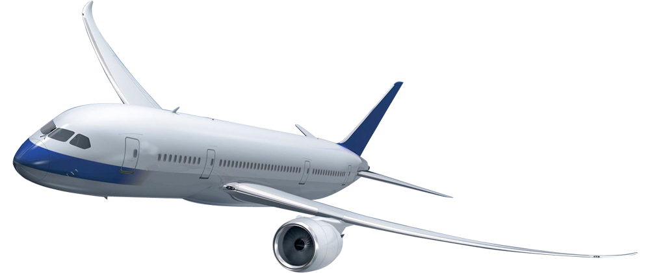
Aviation
Traffic
Anita Gashi

Slide 2
Objective
Identify the time of year with more air traffic
Identify which are busiest Airports in the world
Identify the factors on air traffic

Slide 3
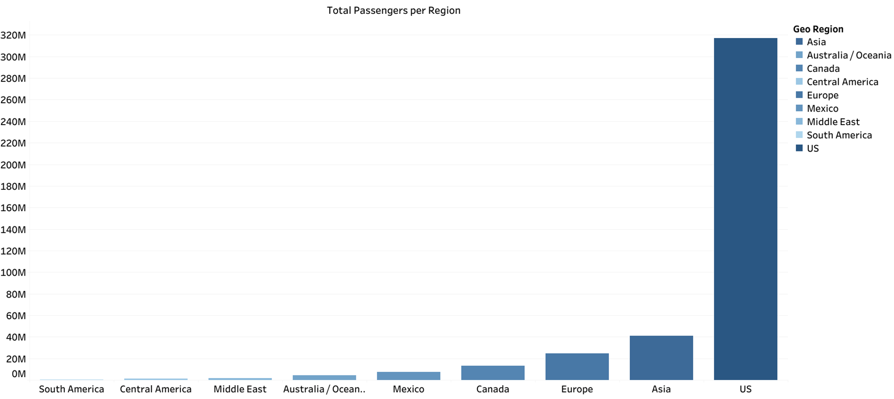

Slide 4
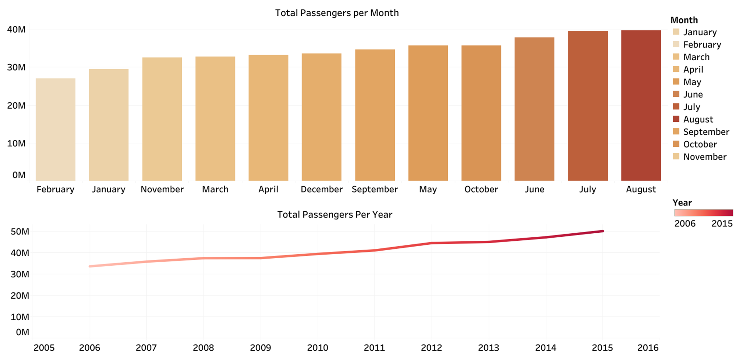

Slide 5
Why June and August are busiest month to fly ?
The middle of June through the middle of August is the peak of summer. Most states are at their warmest and the majority of kids are off from school. Flight prices tend to be very high during these periods.

Slide 6
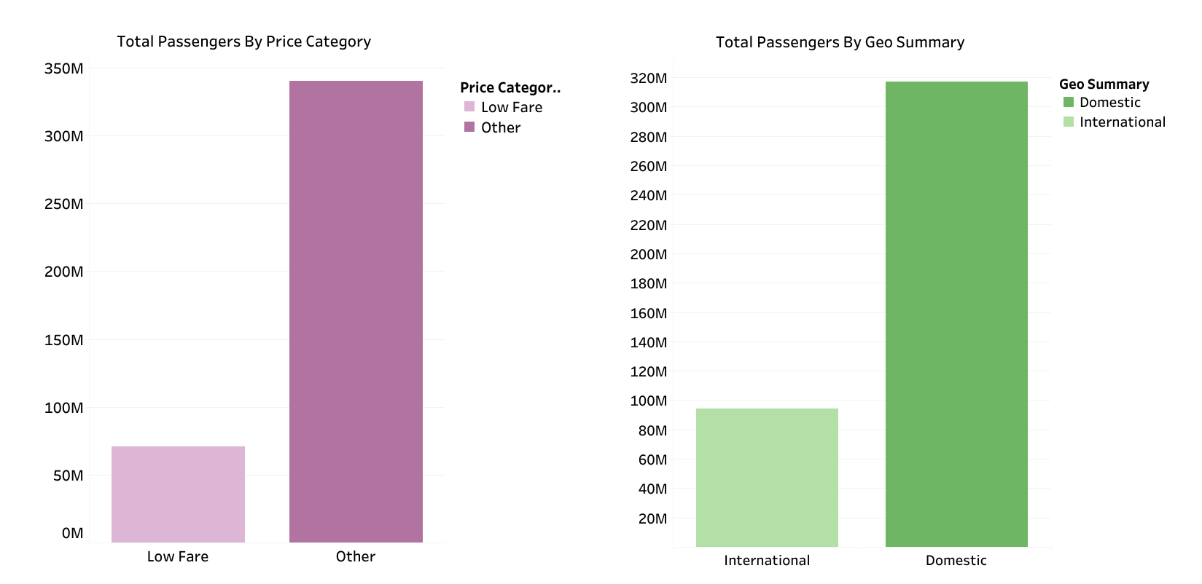

Slide 7
Number one region for domestic flights is USA, after that is China and India
Price of ticets are usually higher during holidays and weekends

Slide 8
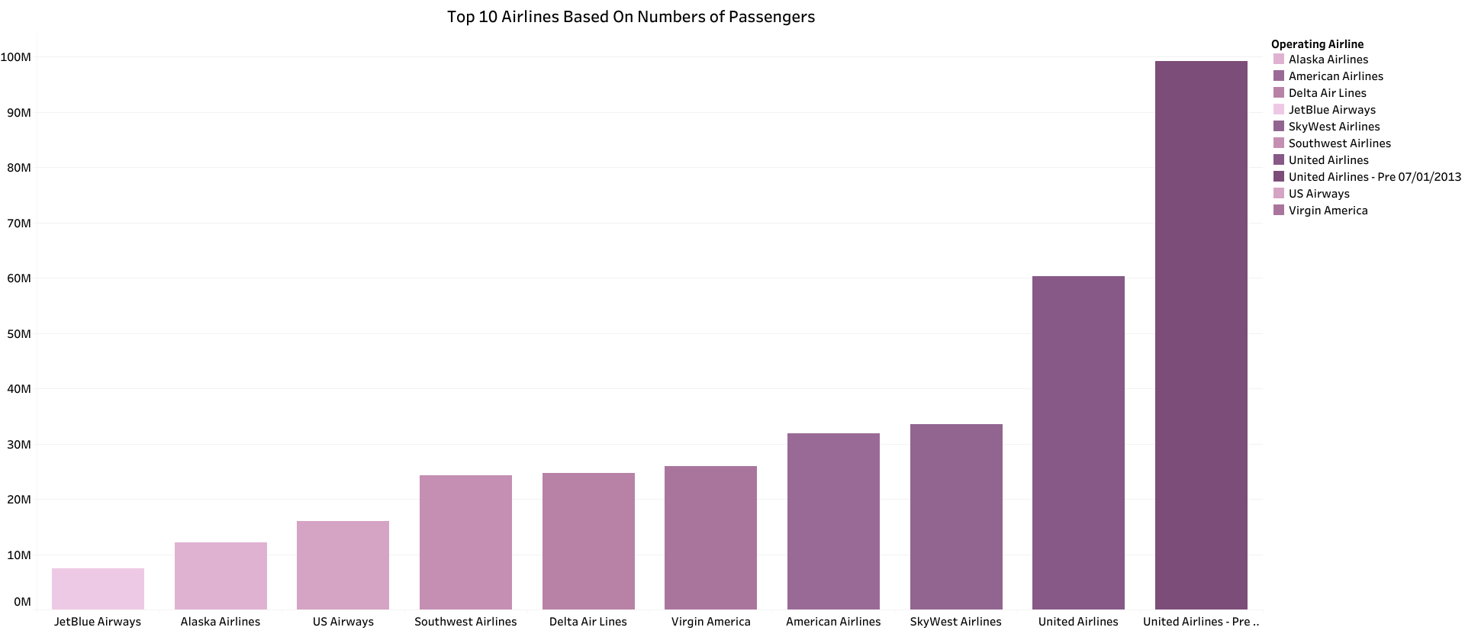

Slide 9
In this part we analyzed the year from 2005-2015 and we saw that the region with the highest number of passenger is USA
The months with highest number of passengers are June, July and August, and during the years 2005-2015 the number of passengers have been increased
And most of the flights were Domestic which means people traveled in the same Country but different place or city.
Based on the number of passengers the 1st one in rank is United Airlines

Slide 10
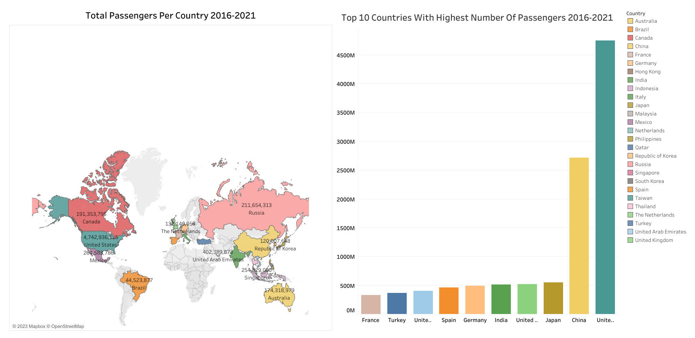

Slide 11
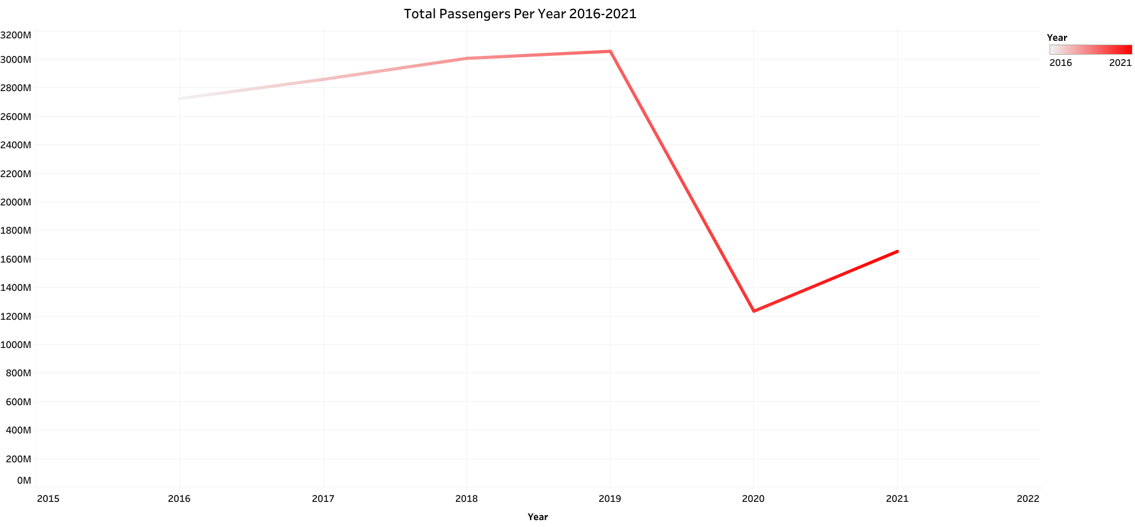

Slide 12
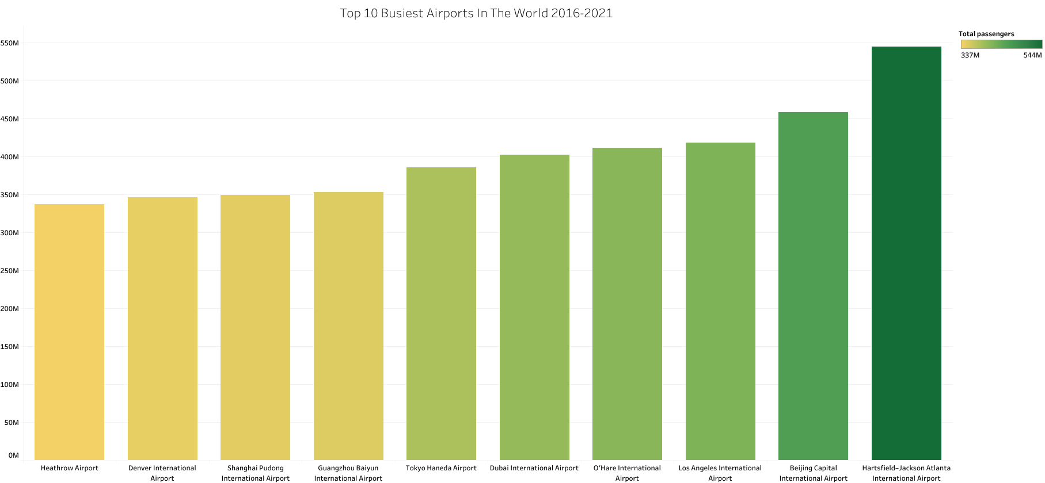

Slide 13
Why Is Atlanta’s Airport so busy ?
Atlanta, though, benefits from a strong home airline — Delta — favorable geography to capture many busy traffic flows, relatively low airport costs, a terminal layout conducive to facilitating flight connections, limited competition from other hubs, and the presence of many medium-sized cities throughout the southeast which need a big regional hub to access the rest of the world

Slide 14
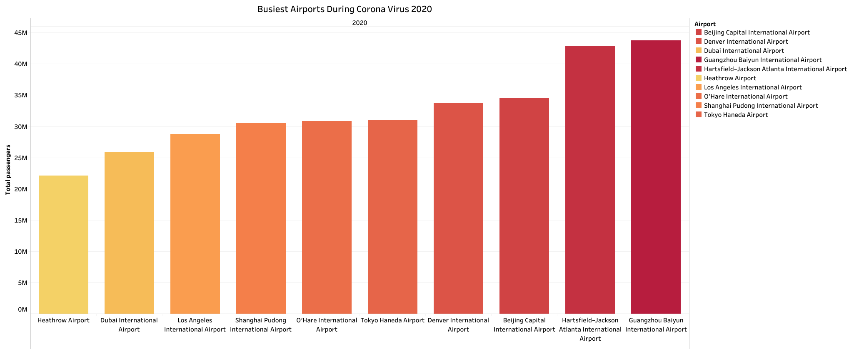

Slide 15
Why Was Guangzhou Bayin became busiest airport during 2020 ?
In November 2020, Baiyun became the only domestic airport to exceed 5 million passengers after the outbreak. Behind these figures was the strong support provided by the rapid resumption of work and production in South China's Guangdong Province, a major manufacturing hub in the nation

Slide 16
In this part I analysed the year 2016-2021
Also in this period of years the region with the highest number of passenger is USA
The year with highest number of passengers was 2019 while 2020 was lowest because of corona virus
As for the busiest airport is Hartsfield-Jackson Atlanta but during the 2020 Pandemic time it was China’s Guangzhou Baiyn Airport

Slide 17

Thank You

